Slide 1
SolidWorks Assembly Tips & Tricks
Brian McElyea, CSWP
Intuitive Research and Technology Corporation
http://www.irtc-hq.com/
CADFanatic.com

Slide 2
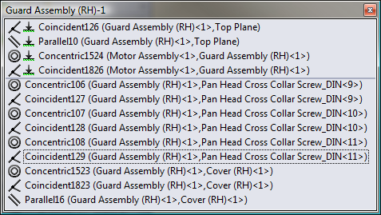
Assembly Mates
View Mates
Overview of mates to selected entity
Shows “path to ground” mates
Use Mate References
Insert, Reference Geometry, Mate Reference…
Name Mate References for automatic mates

Slide 3
Assembly Tools
Use Alt-Drag to Mate Parts (Smart Mates)
Easily apply single mates
Use as a pseudo-insert mate for fasteners (create two mates at once)
Use Ctrl-Drag to Copy Parts

Slide 4
Assembly Tools
Selection Tools
Volume Select…
Select Mated To…
Invert Selection
Select Suppressed
Select Internal Components
Select Toolbox
Advanced Select
Very specific: display style; references; etc.

Slide 5
Assembly Tools (cont.)
Isolate
Temporarily hide unneeded components
Easily create multiple Display States
Works on bodies in multi-body parts too!
Tab to hide
Doesn’t work in multi-body parts
Unload Hidden Components
Show Hidden Components
Combine Isolate with Show Hidden Components for easy, powerful selection

Slide 6
Assembly Tools (cont.)
Folders
Group similar or related entities
Works for mates
Allows quick and easy suppression
Tags
Mark components, mates, and features
Provides another mechanism for searching
Comments

Slide 7
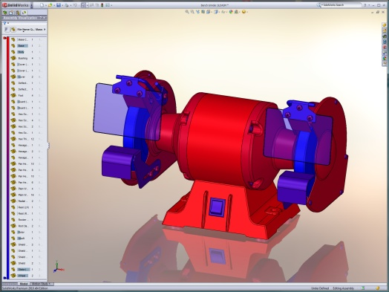
Assembly Tools (cont.)
Assembly Visualization
Mass distribution
Rebuild Time
Cost breakdown
Any custom property can be used

Slide 8
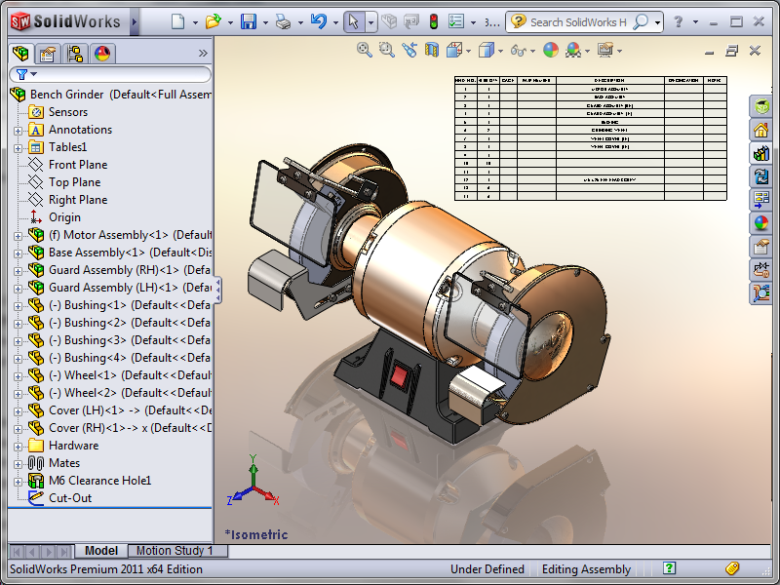
Assembly Tools (cont.)
Assembly Bill of Materials (BOM)
Model-Based Definition (MBD)
Quick overview to check properties or quantities
Can reuse assembly BOM in drawings

Slide 9
Assembly Tools (cont.)
Magnifying Glass
Not strictly an assembly tool; also available in parts
Allows detailed model inspection/ selections without changing overall view
Activated with “G” key (default);
press “G” or click to close
Magnifying glass follows mouse; use Ctrl+MMB to pan with more control
Scroll wheel zooms in/out
Hold Ctrl to select multiple entities
Alt + scroll wheel sections model normal to screen

Slide 10
Assemblies - Modeling Practices
Unique Filenames
Use descriptive names (I usually add the project name as a suffix to the part name when initially designing, i.e., “BRACKET, PROJECT 1.sldprt”)
Use part numbers
Simple Folder Structure
K.I.S.S.: Keep It Simple, Stupid!
Single folder will force unique filenames
Build “Real Life” Assemblies
Avoid flat assembly structures; use subassemblies
Flat structures update all mates on rebuild
Subassemblies only update if necessary

Slide 11
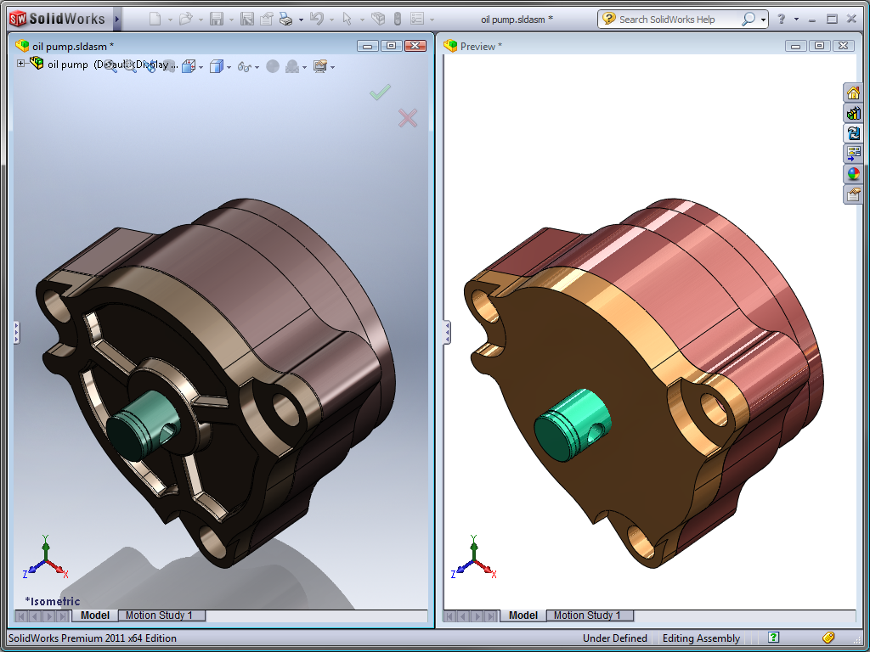
Sharing Data
Defeature
Removes detail from a part or assembly & saves the results to a new file with no feature definition/history (i.e., a dumb solid)
Can preserve assembly motion (certain mates, faces, etc.)
Can store settings for future use, publish to 3D ContentCentral, or save model as separate file
Saves assemblies as one file with virtual parts

Slide 12
Large Assemblies
Use 64-bit OS
As Much RAM as Possible
If on 32-bit OS:
Watch RAM on video adapter
32-bit OS’s allocate 2GB RAM/process
Video RAM is part of that 2GB pool!

Slide 13
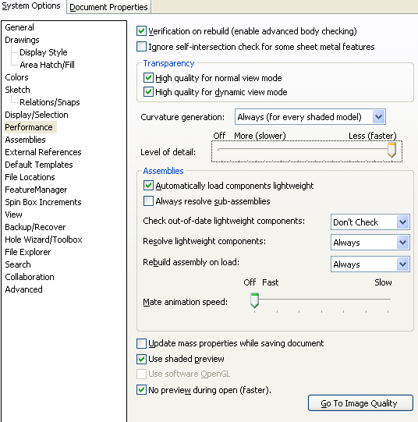
Large Assembly Performance
Settings to Optimize Performance
Clear “Verification on rebuild” for truly large assemblies
Tools> Options|System Options|Performance|Assemblies:
Check “Auto load components lightweight”
Clear “Always resolve…”
Personal preference on “Check out-of-date…”
“Always” on “Resolve lightweight components”
“Rebuild assembly on load” best answered by experience with a particular assembly
“Mate animation speed” is “Off”
SOURCE: Building Better Assemblies SWW2010 Presentation by Brian Lindahl, Senior Engineer, CAD_Speed-Up, LLC

Slide 14
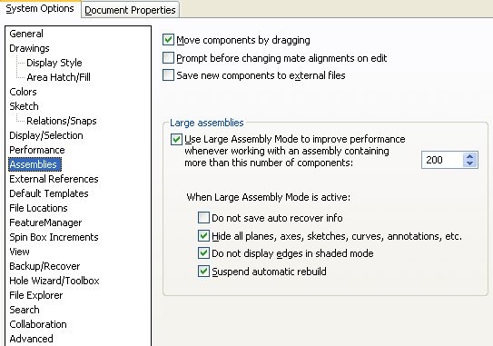
Large Assembly Performance (cont.)
Settings to Optimize Performance (cont.)
Tools|Options|System Options|Assemblies|Large Assemblies:
Check “Use Large Assembly Mode…”, and set to a manageable number, roughly between 100 & 500.
Define your “Large Assembly Mode” with as many of the four selectable choices as possible checked. All improve system speed, can you work with that setting?
SOURCE: Building Better Assemblies SWW2010 Presentation by Brian Lindahl, Senior Engineer, CAD_Speed-Up, LLC

Slide 15
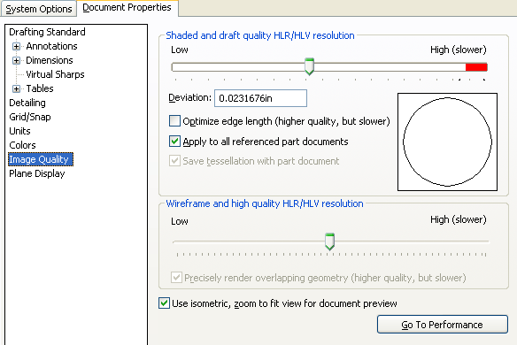
Large Assembly Performance (cont.)
Settings to Optimize Performance (cont.)
Tools|Options| Document Properties| Image Quality|Shaded and draft quality HLR/HLV resolution:
Always keep resolution as low as possible to improve performance; exceptions: extremes in part sizes, graphic presentation of model to an end user.
SOURCE: Building Better Assemblies SWW2010 Presentation by Brian Lindahl, Senior Engineer, CAD_Speed-Up, LLC

Slide 16
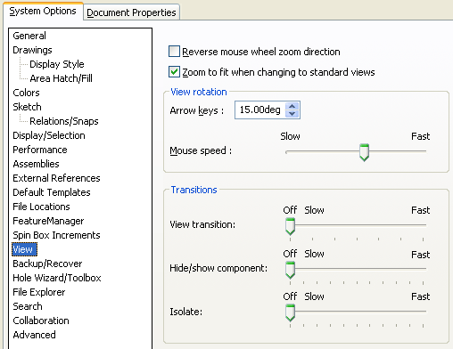
Large Assembly Performance (cont.)
Settings to Optimize View Performance
Tools|Options| System Options| View|Transitions:
Set to “Off” to get fastest update possible
Transitions are just fluff and wow-factor.
SOURCE: Building Better Assemblies SWW2010 Presentation by Brian Lindahl, Senior Engineer, CAD_Speed-Up, LLC

Slide 17
Large Assemblies – Modeling Practices
Assemblies solve serially in this order:
Parts & assemblies
Mates
Component patterns
Assembly dependent items
SOURCE: Improving Large Assembly and Drawing Performance, SWW2010 Presentation by Craig Therrien, Product Manager, SolidWorks Corporation

Slide 18
Large Assemblies – Modeling Practices
Mate Performance in Order of Speed (fast to slow):
Relation mates (coincident, parallel, etc.)
Logical mates (width, cam, gear)
Distance mates
Limit mates
SOURCE: Improving Large Assembly and Drawing Performance, SWW2010 Presentation by Craig Therrien, Product Manager, SolidWorks Corporation

Slide 19
Large Assemblies – Modeling Practices
Avoid flat assembly structures; use subassemblies (model should reflect real-life)
Flat structures update all mates on rebuild
Subassemblies only update if necessary
Yes, this is important enough to say twice!
SOURCE: Improving Large Assembly and Drawing Performance, SWW2010 Presentation by Craig Therrien, Product Manager, SolidWorks Corporation

Slide 20
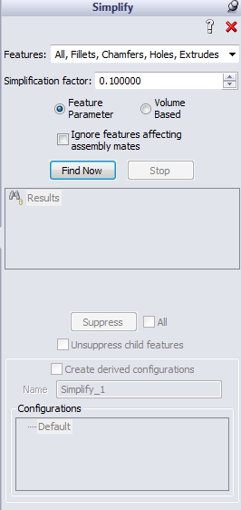
Large Assemblies – Modeling Practices
Work Local!
Large Assembly Mode
Suspend Automatic Rebuilds
Make all your changes, and then manually rebuild all at once
Quick view/Selective Open
Create simplified configurations of parts/assemblies
Manually
Automatically
Tools, Find/Modify, Simplify…
Use SpeedPak

Slide 21
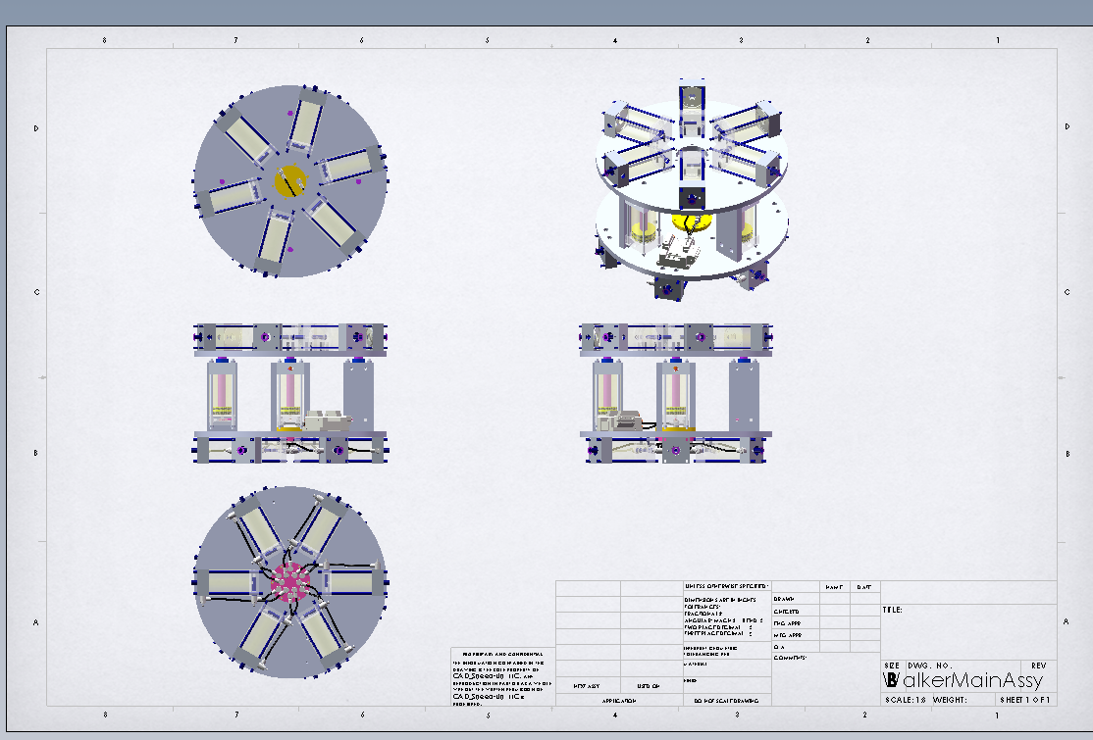
Large Assembly Drawings
Display Mode should be Shaded without edges until drawing is complete
Hide behind plane:
RMB on a plane IN THE VIEW of interest (in the FeatureManager) and choose Hide Behind Plane
Automatically populate the ‘Components to be hidden’ Dialog with components that reside entirely behind (or in front) of the selected plane
Not a dynamic setting – if new children components are added behind the plane, these are NOT hidden yet
More views = slower
Create the views that need work first; complete all work possible; make next view
SOURCE: Building Better Assemblies SWW2010 Presentation by Brian Lindahl, Senior Engineer, CAD_Speed-Up, LLC

